Slide 1
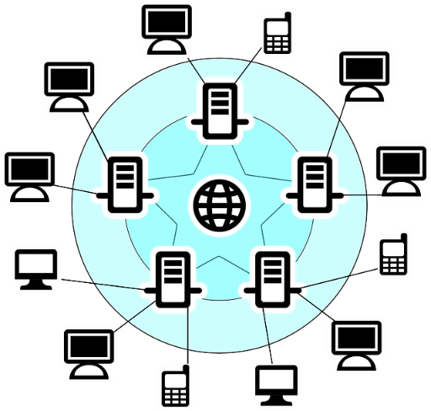
Network Topologies Layers and Packet Switching

Slide 2
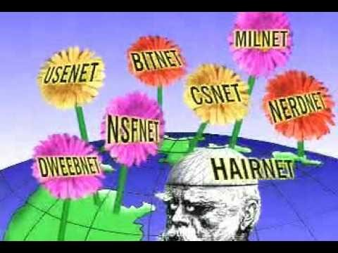
What is the Internet

Slide 3
Learning Objectives
Explain the terms and role of Packets
Understand the concept of Packet Switching
Identify Protocols and their role.

Slide 4
Big Picture
Networks transfer and receive a lot of data
In one minute on the Internet: 640TB data transferred. This lesson considers how such a huge amount of data is sent to ensure that it arrives at the correct computer

Slide 5
Packet switching
Imagine that you have a large LEGO model to post through a letter box but, it does not fit.
What could you do?
What if you could take the model apart and then post it through the letter box and then reassembly it?
This is packet switching
Notes:
Lego tube

Slide 6
Same Idea for a Computer
Now image you want to email a photo, first it is broken down into small packets of data
Each packet is then given a header which contains the IP address of the network and device that it is being sent to.
It also contains the IP address of the network that it was sent from

Slide 7
The Header
The header also contains the packet number as well as the total number of packets, for example packet 4 of 60, packet 45 of 60.
When the packets arrive at the destination this information is used to reassemble the data.
Packets can be lost so sometimes the computer request the packet to be sent again, if a packet never arrives then it is deleted by the router.

Slide 8
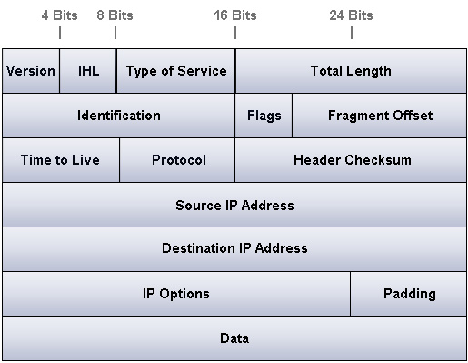
An Example Packet

Slide 9
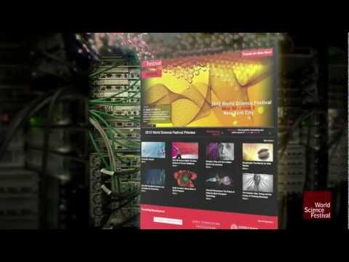
Video Example

Slide 10
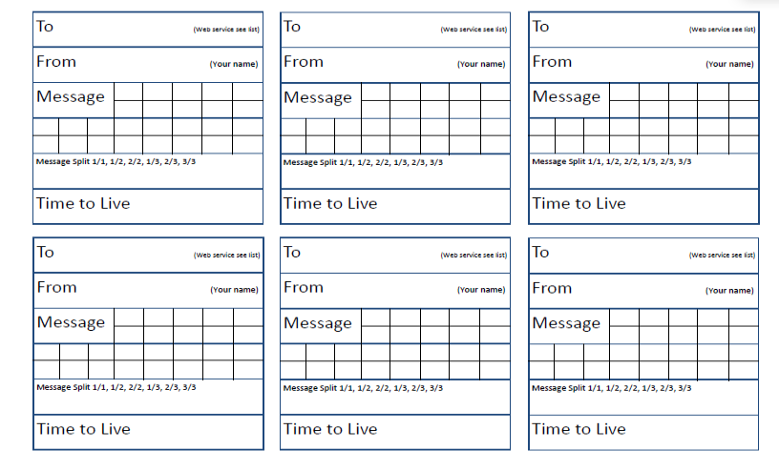
ACTIVITY
Notes:
Play packet switching game
Resources from http://code-it.co.uk/netintsearch

Slide 11
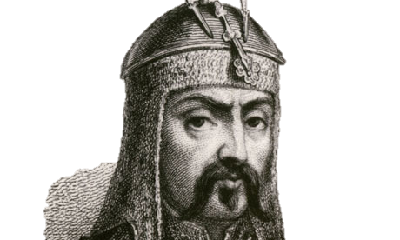
PROTOCOLS
Network protocols are a set of rules or conventions which control the communication between devices on a network

Slide 12
Do you Know your Protocols?
TCP/IP
HTTP
HTTPS
FTP
POP
IMAP
SMTP

Slide 13
Key PROTOCOLS
TCP/IP (Transmission Control Protocol/Internet Protocol)
HTTP (Hyper Text Transfer Protocol)
HTTPS (Hyper Text Transfer Protocol Secure)
FTP (File Transfer Protocol)
POP (Post Office Protocol)
IMAP (Internet Message Access Protocol)
SMTP (Simple Mail Transfer Protocol)

Slide 14
Do you Know your Protocols?
TCP/IP
HTTP
HTTPS
FTP
POP
IMAP
SMTP

Slide 15
Plenary
BBC Online test: http://www.bbc.co.uk/education/guides/zp9jpv4/test

Slide 16
Plenary
“Share with your table one new thing you have learnt today”
Log onto Socrative and complete the Learning questions
What have you learnt today?

Slide 17
Plenary
Create a short film explain the concept of packet switching or Layers when send and receiving data.
Create a quiz on the lesson content, layers and packet switching

