Slide 1
Interfacing with a database
Python can also be used to write to a database
A database is “a persistently organised” collection of data – for example, the contact details on your phone, a TV guide, a stock control system for a product.
Database can therefore come in many formats for example, text, spreadsheet and CSV.
CSV stands for Comma Separated Variable

Slide 2
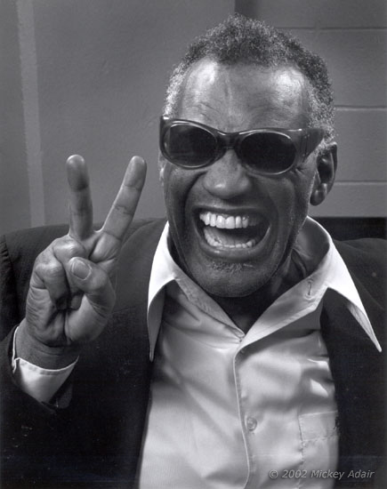
An array
An array is the word used to describe a list, for example a shopping list
shopping_list = [“cake”, “pie”, “ham”, “magazine”]
A 3D array is a list which holds more than one list
students = [['dave', 14, '11DA'], ['liz', 18, '7ED'], ['kerry', 'liz', '8MD2']]
Note the use of the brackets and the layout
More on Arrays in another lesson

Slide 3
Writing data from an array to a csv file
import csv
students = [['dave', 14, '11DA'], ['liz', 18, '7ED'], ['kerry', 'liz', '8MD2']]
myfile = open('output.csv','w')
wr = csv.writer(myfile, quotechar=None)
wr.writerows(students)
myfile.close()
Notes:
Creates a file called output, writes each item in the list into the CSV file

Slide 4
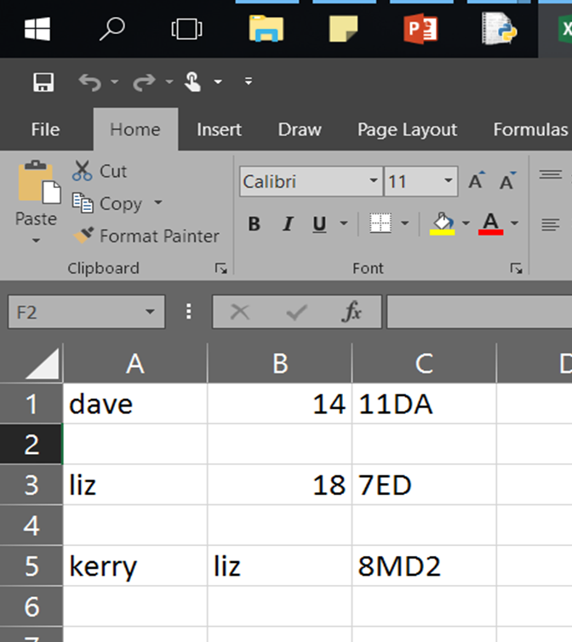
Did you get this?

Slide 5
Add another array to the list
import csv
students = [['dave', 14, '11DA'], ['liz', 18, '7ED'], ['kerry', 'liz', '8MD2']]
myfile = open('output.csv','w')
wr = csv.writer(myfile, quotechar=None)
wr.writerows(students)
myfile.close()
Add another array here or
Create a new array on line two and add the name of the array to the students array
Notes:
Creates a file called output, writes each item in the list into the CSV file

Slide 6
Reading from a database to an array
import csv
students = []
file = open('output.csv', 'rt')
reader = csv.reader(file)
for row in reader:
print (row)
f.close()
Notes:
Does not write to the ‘student list’ only prints the values

Slide 7
YOUR TURN
Add to new entries to the CSV Database
Save the file
Create the code and read all the data from the file
Notes:
Does not write to the ‘student list’ only prints the values

Slide 8
Reading from CSV file to an array
import csv
students = []
with open('output.csv', 'r') as f:
reader = csv.reader(f)
students = list(reader)
print (students)

