Slide 1
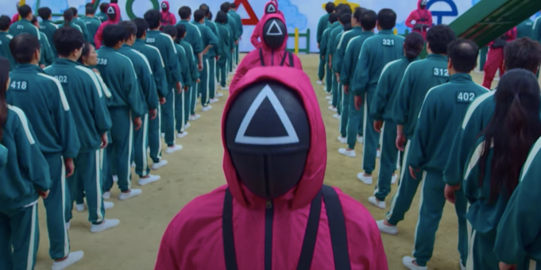
SQUID GAME

Slide 2
SQUID GAME
Behaviour expectations

Slide 4
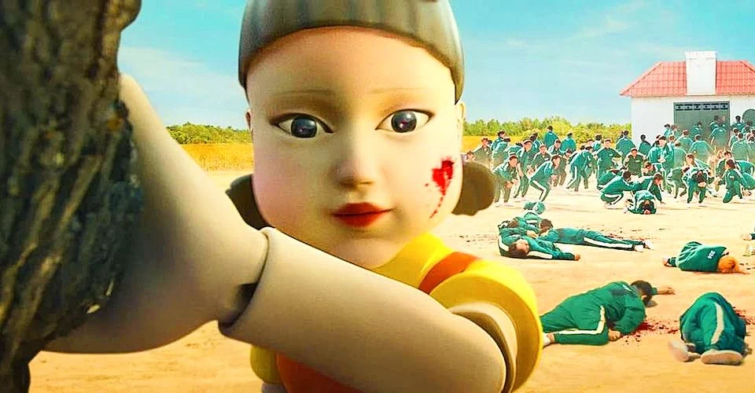
NO TALKING, SILENT WORK

Slide 5
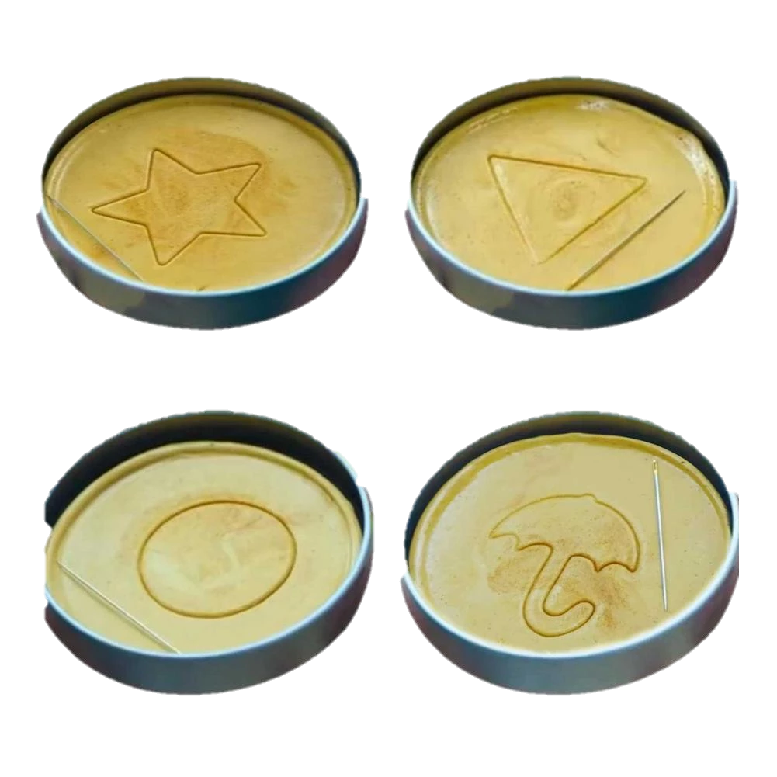
DALGONA cookies

Slide 6
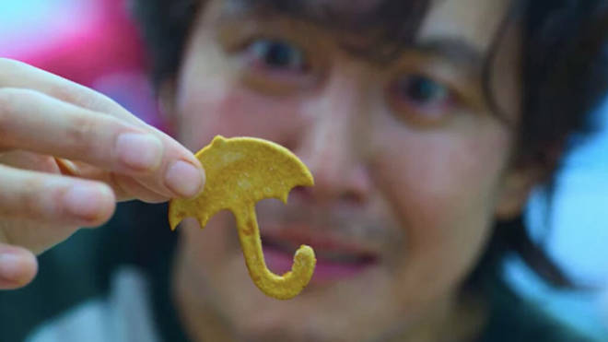

Slide 7
Let’s begin

Slide 8
DALGONA cookies

Slide 9
DALGONA cookies

Slide 10
DALGONA cookies

Slide 11
DALGONA cookies

Slide 12
DALGONA cookies

