Slide 1
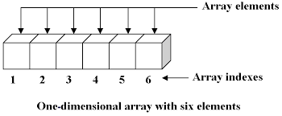
Manipulating Arrays

Slide 2
Sorting all data ascending
students = [["dave", 14, "11DA"], ["liz", 18, "7ED"], ["kerry", 7, "8MD2"]]
print (students)
print ("")
## sort the list ###
students.sort()
print(students)
Notes:
Uses the name of the list and .sort()
Sorts the lists alphabetically by the first item in each list, the name

Slide 3
Sorting data by choice, by age
students = [["dave", 14, "11DA"], ["liz", 18, "7ED"], ["kerry", 7, "8MD2"]]
print (students)
## sort the list by a column age###
def getKey(item):
return item[1]
print(sorted(students, key=getKey))
Notes:
Create a function or a key to store the item position number, age in in positon 1
Uses return item[1] to sort by position one, the ages

Slide 4
Sorting all data by choice, ascending or descending
students = [["dave", 14, "11DA"], ["liz", 18, "7ED"], ["kerry", 7, "8MD2"]]
print (students)
print ("")
print(sorted(students, reverse=True))
This list is sorted in reverse by the name data

Slide 5
Sorting all data by single column data, ascending or descending
students = [["dave", 14, "11DA"], ["liz", 18, "7ED"], ["kerry", 7, "8MD2"]]
print (students)
## sort the list by a column age###
def getKey(item):
return item[1]
print(sorted(students, key=getKey, reverse=True))
print(sorted(students, key=getKey, reverse=False))
Notes:
Sorts by age column, finds the item postion [1] the age and then reverse = True to sort in descending order

Slide 6
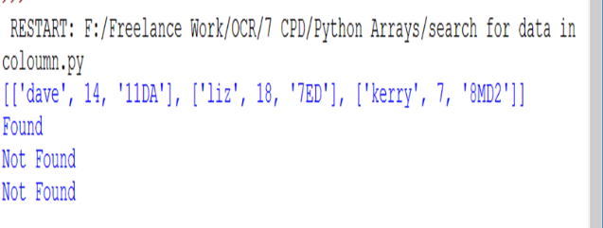
Searching for data in a list (list 2)
students = [["dave", 14, "11DA"], ["liz", 18, "7ED"], ["kerry", 7, "8MD2"]]
print (students)
#search for data in a particular list (list 1)
for i in students[1]:
if i == 'liz':
print ("Found")
else:
print ("Not Found"
Notes:
Searches for ‘Liz’ in list 2 finds it in the first column, but not the other two

Slide 7
Searching for data in a list (list 3)
students = [["dave", 14, "11DA"], ["liz", 18, "7ED"], ["kerry", 7, "8MD2"]]
print (students)
#search for data in a particular list (list 3)
for i in students[2]:
if i == 'liz':
print ("Found")
else:
print ("Not Found")
Notes:
Searches for ‘Liz’ in list 3, does not find the entry, "kerry", 7, "8MD2’, no Liz

Slide 8
Searching for data in a column
students = [["dave", 14, "11DA"], ["liz", 18, "7ED"], ["kerry", "liz", "8MD2"]]
found = "dave" in (i[0] for i in students)
print (found)
found = "dave" in (i[1] for i in students)
print (found)
Notes:
Searches for the name “dave” in each of the lists in position 0. the first entry.
Searches the second column for dave, this is False as the column contains a number.

Slide 9
Copying a list
numbers = [[3, 5, 78], [89, 34, 23]] #array = [['3', '5', '78'], ['89', '34', '23']] #array
new_array = numbers
print(numbers)
print(new_array)
### however this is not a copy of the list
new_array = list(numbers)
Notes:
Must use the list method to copy a new list.
Otherwise the copy overwrites to position in memory of the original list (it is mot a new list)

Slide 10
Copying a list: Looking for data and copying
numbers = [[3, 5, 78], [89, 34, 23]]
new_list_three = []
for i in numbers[0]:
if i > 10:
new_list_three.append(i)
print (new_list_three)
Notes:
Searches for items in one sub lits with a value greater than 10
Then writes them to a new list called (new_list_three)

Slide 11
Copy a list, searching for data in all columns
numbers = [[3, 5, 78], [89, 34, 23]] #array = [['3', '5', '78'], ['89', '34', '23']] #array
new_list_three = []
## search one coloumn in all lists)
for i in (i[1] for i in numbers):
if i > 10:
new_list_three.append(i)
print (new_list_three)
Notes:
Search each sub list in the array, each item and checks column two [1] if the number is bigger than 10 then it appends it to new list.

Slide 12
Running calculations on Arrays SUM
students = [[14, 8, 1],
[7, 8, 9],
[12, 6, 9]]
#add row 1, 14+7+12
print (sum(row[0] for row in students))
For the last column use:
print (sum(row[2] for row in students))
Notes:
Takes the first entry in each row [0] and uses the sum function to add them together 14+7+12 = 33
Row can be replaced with any word you could use column if you prefer

Slide 13
Running calculations on Arrays Average (Mean)
from statistics import mean
students = [[14, 8, 10],
[7, 8, 10],
[12, 6, 10]]
print (mean(column[2] for column in students))
Notes:
Find the mean value of column 3, 10+10+10 = 30

Slide 14
Running calculations on Arrays Max / Min
from statistics import mean
students = [[14, 8, 10],
[7, 8, 10],
[12, 6, 10]]
print (max(row[0] for row in students))
Replace with min for the lowest number
Notes:
Works on strings as well returning the alphabetical positions

Slide 15
Saving 2d array to a CSV file
import csv
students = [['dave', 14, '11DA'], ['liz', 18, '7ED'], ['kerry', 'liz', '8MD2']]
myfile = open('output.csv','w')
wr = csv.writer(myfile, quotechar=None)
wr.writerows(students)
myfile.close()
Notes:
Creates a file called output, writes each item in the list into the CSV file

Slide 16
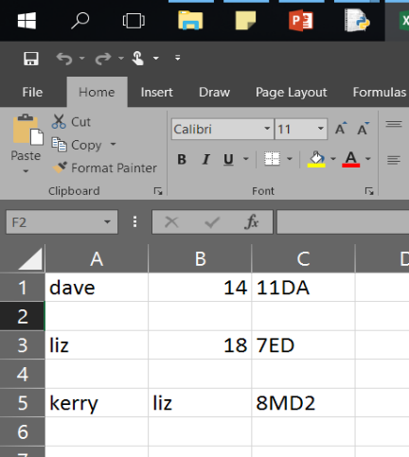

Slide 17
Reading from CSV file to an array
import csv
students = []
with open('output.csv', 'r') as f:
reader = csv.reader(f)
students = list(reader)
print (students)

