Slide 1
Top Trumps

Slide 2
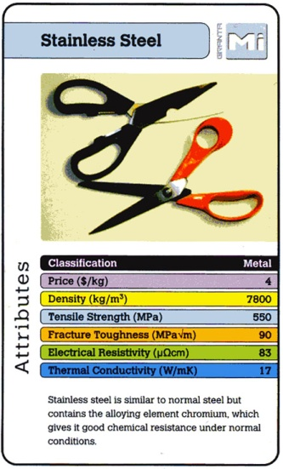
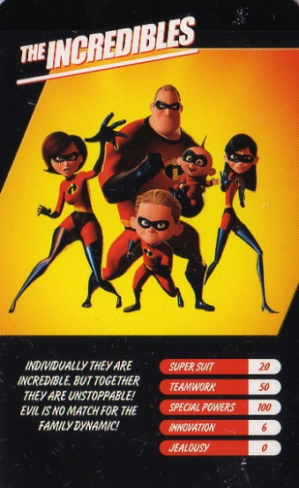
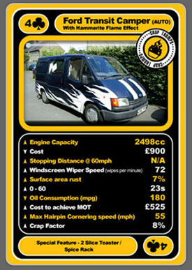
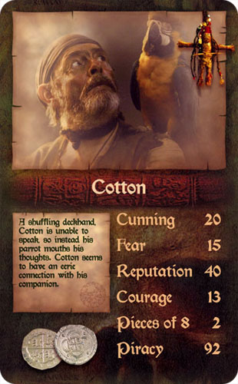
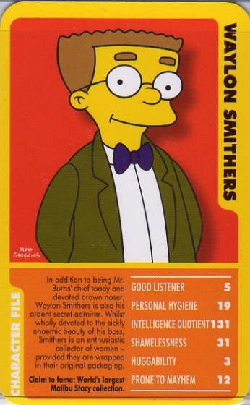

Slide 3
This Project
Decide on your topic
Decide on skill / power categories, at least 5
Create Database Design
Add data
Create a Form
Find pictures
Play!

Slide 4
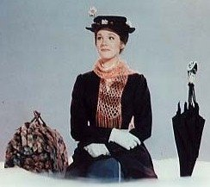
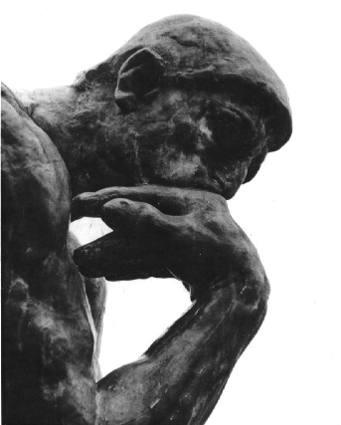
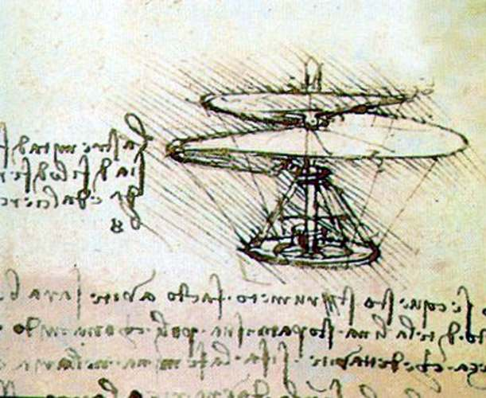
Independent Enquirers
Team Workers
Effective Participators
Self Managers
Reflective Leaners
Creative Thinkers

