Slide 1
What are the four shapes used in an algorithm?

Slide 2
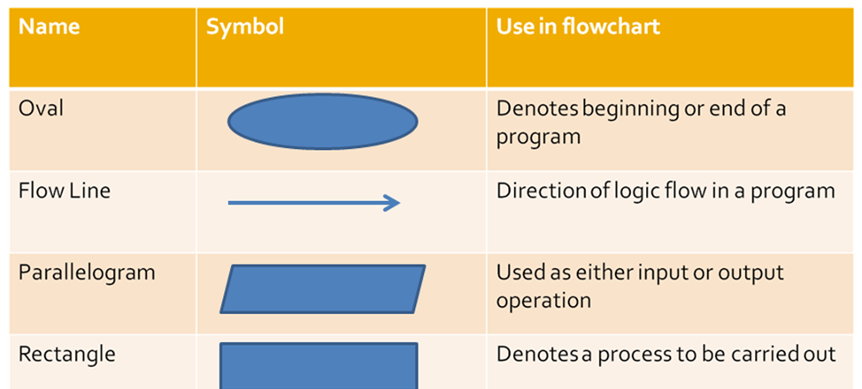

Slide 3
Using the straws create the relevant shape
Process
Output
Decision
Input
Direction of flow
Do you like chocolate?
Name = Dave

