Slide 1
Unit 2.5 Translators and Facilities of Languages – Lesson 2

Slide 2
Big Picture – Activity 1/2
What are the key differences between the different levels of Programming Languages?
What differences are there between the different Language Translators?

Slide 3
Learning Objectives
To be able to describe how an Assembler works
To be able to describe the differences in operation between a Compiler and Interpreter
To be able to describe the common tools and facilities in an Integrated Development Environment (IDE)

Slide 4
Engagement Activity
Based on the Flipped Learning Activity:
On one post-it note put something that you know about the topic on language translators
On another post-it note put something that you would like to know more about
Place these on separate boards at the front.

Slide 5
Key Words
Compiler
Interpreter
Assembler
Source Code
Object Code
Executable Code
Debug
Translator
IDE

Slide 6
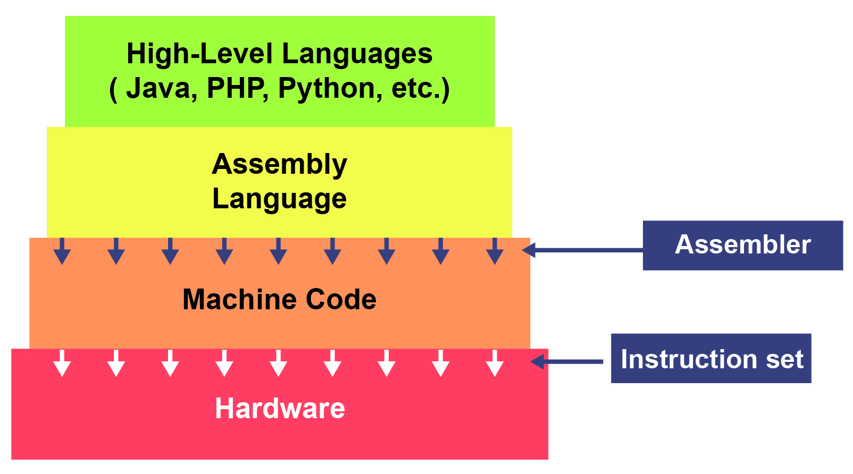
Content
Language Translators are used to translate a language into a form that the will be able to directly execute
Assemblers are used for 2nd Generation
Compilers/Interpreters are used for 3rd Generation

Slide 7
Activity 3
You will be handed either a sheet on Compilers or Interpreters:
Spend 10-15 minutes completing the task given on the sheet to produce a diagrammatic form of the text (e.g. MindMap, Cartoon etc).
Work with a partner to explain to them what is meant by Compiler/Interpreter using only your notes.
Check understand (peer assess each other)

Slide 8
Content
Assemblers
Translate Assembly Language code into Machine Code
Used for Device Drivers
Used when fast execution is required or limited memory/file size
Difficult to write in (easier than Machine code)

Slide 9
Content
Compilers
Translate entire source code all in one go into Machine Code
Optimise code
Used at the end of development (ready for shipping)
Error Reports created along with Object Code

Slide 10
Content
Interpreters
Translate and execute source code
Line by Line, Statement by Statement
Source code is checked for syntax – if correct, code is executed. If incorrect interpreting is stopped.
Used for development (aide debugging)

Slide 11
Content
Integrated Development Environment (IDE)
Editor (for writing the code)
Error Diagnostics (such as de-bug facilities)
Run-Time Environment
Translators

Slide 12
Activity 4
Open up a programming language that you are familiar with and produce a series of screen shots / notes that identify:
- Where the editor is located and how it is used
- Where the error diagnostics can be found and used
- How the run-time environment looks and the features of this
- Examples of using the Compiler and Interpreter

Slide 13
Plenary
Questioning Round
Homework:
Produce a short report describing the differences between the language translators, how these apply to generations of languages and where each would be used

Slide 14
OCR Resources: the small print OCR’s resources are provided to support the teaching of OCR specifications, but in no way constitute an endorsed teaching method that is required by the Board, and the decision to use them lies with the individual teacher. Whilst every effort is made to ensure the accuracy of the content, OCR cannot be held responsible for any errors or omissions within these resources. © OCR 2016 - This resource may be freely copied and distributed, as long as the OCR logo and this message remain intact and OCR is acknowledged as the originator of this work.
OCR acknowledges the use of the following content: n/a
Please get in touch if you want to discuss the accessibility of resources we offer to support delivery of our qualifications: resources.feedback@ocr.org.uk

