Slide 1
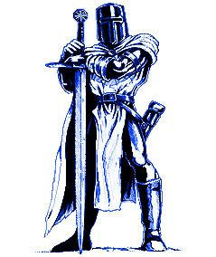
The
Knight’s
Tour

Slide 2
The Problem
A gallant and brave knight must traverse the lands to rescue the princess and claim his rightful place in the kingdom
A Knight on a board has to visit every square without passing through the same square more than once. Then returns to the starting square

Slide 3
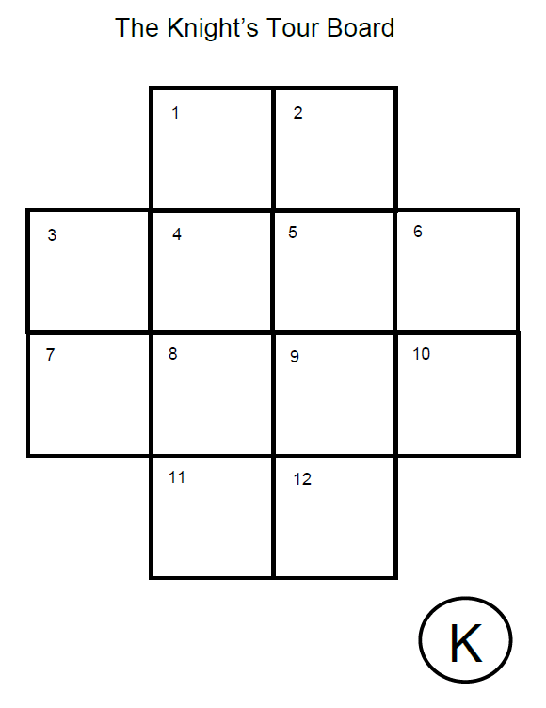
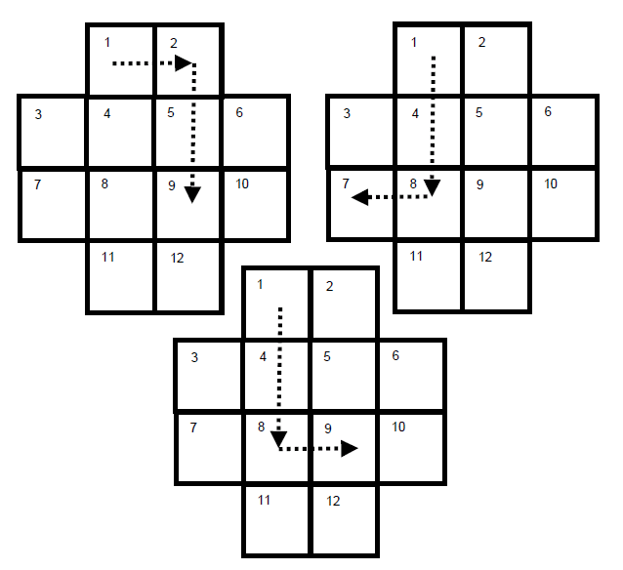
Notes:
Give students a knight and see if they can solve it

Slide 4
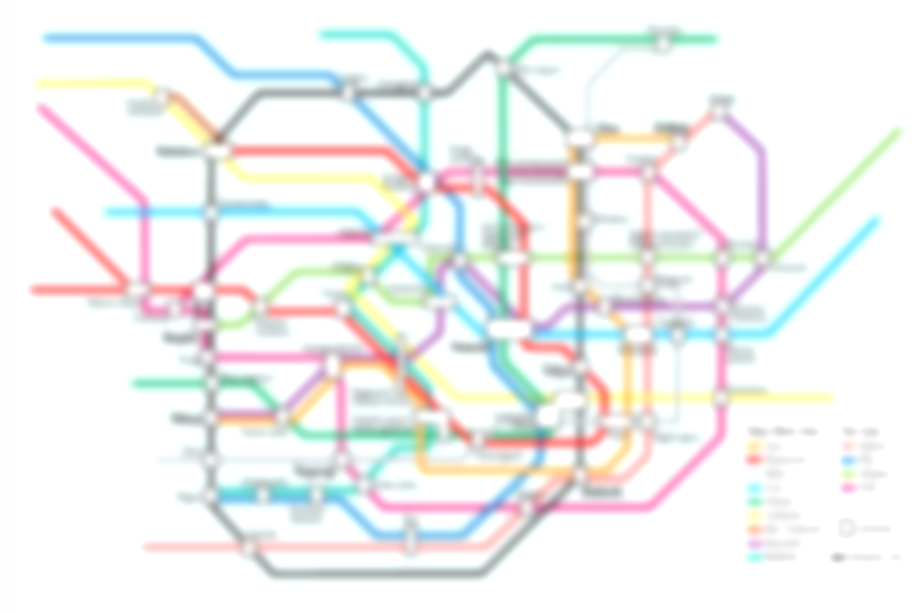
A similar Problem?
You are a tour guide and must come up with a tour that gets a tourist from their London hotel to all the city sights and back to their hotel at the end of the day.
The tourists get upset if they visit the same place twice
Notes:
How might we solve this?

Slide 5
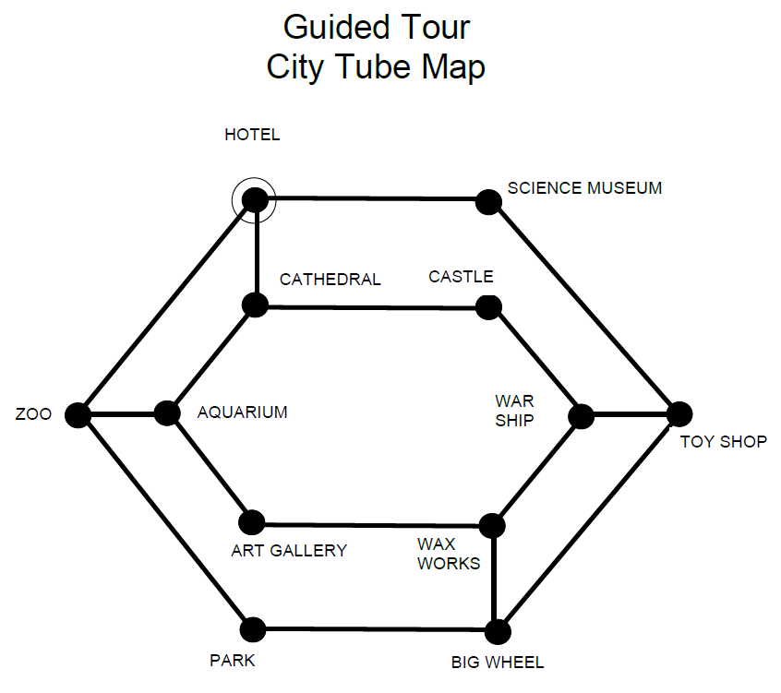
Consider another way
Computer Scientist create a diagram
This is called a Graph
It is easier to plan and find the solution

Slide 6
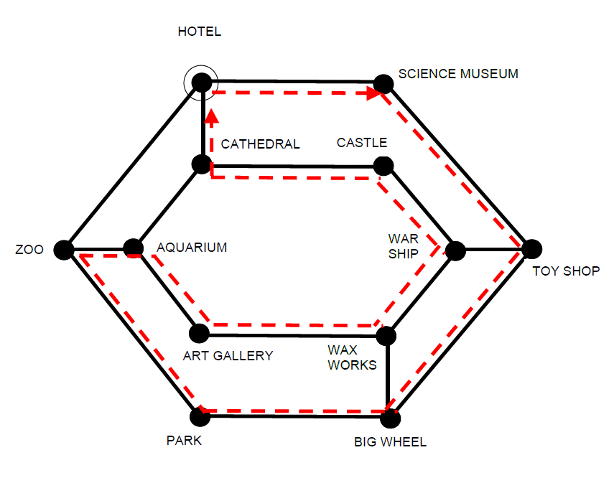

Slide 7
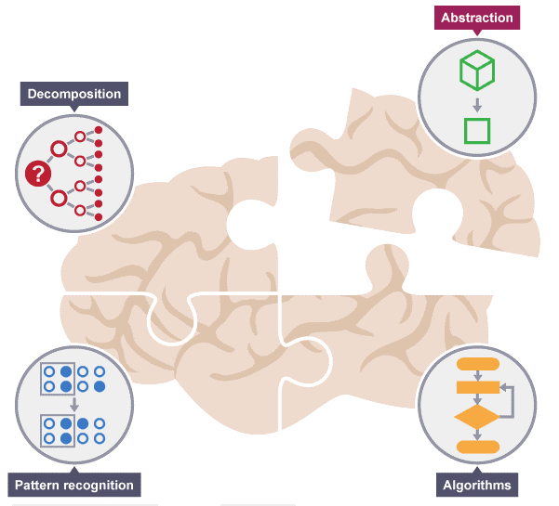
Abstraction
Using abstraction to make a model
Hides all the detail apart from what is needed
Abstraction is one of the four cornerstones of Computer Science. It involves filtering out – essentially, ignoring the characteristics that we don't need in order to concentrate on those that we do.

Slide 8
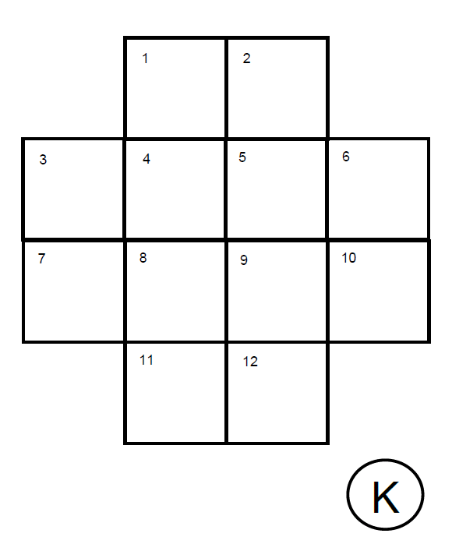
1. Use Abstraction to solve the Knight’s Tour
1 , 7
1, 9
1, 6

Slide 9
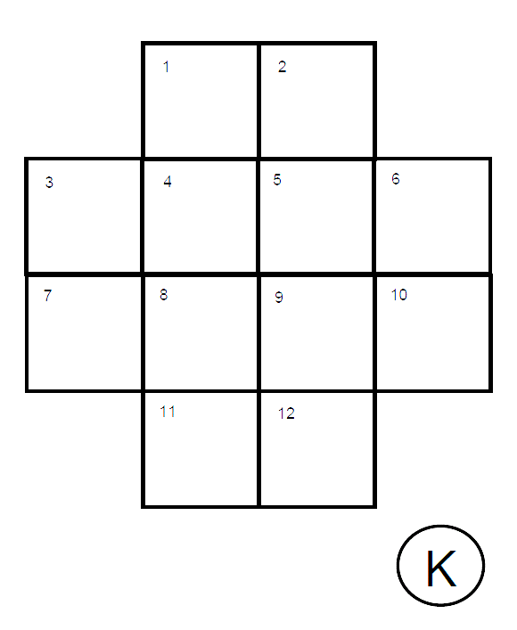
Use Abstraction to solve the Knight’s Tour
1
Add the nodes which the Knight can go to from a particular square.
6
9
7

Slide 10
Use Abstraction to solve the Knight’s Tour
1
2
Continue until all the Boxes have numbers in them.
This will create a ‘messy’ diagram of the possible paths that the Knight can go to
3
6
8
9
10
7

Slide 11
Another way to Use Abstraction to solve the Knight’s Tour
Start at a square and move to the next square that you can
Number it and draw a line between the points
Then jump to the next free square
Repeat until you cannot move any further
Select a new square, repeat steps 1, 2, 3, 4
1
2
6
7
8
12

Slide 12
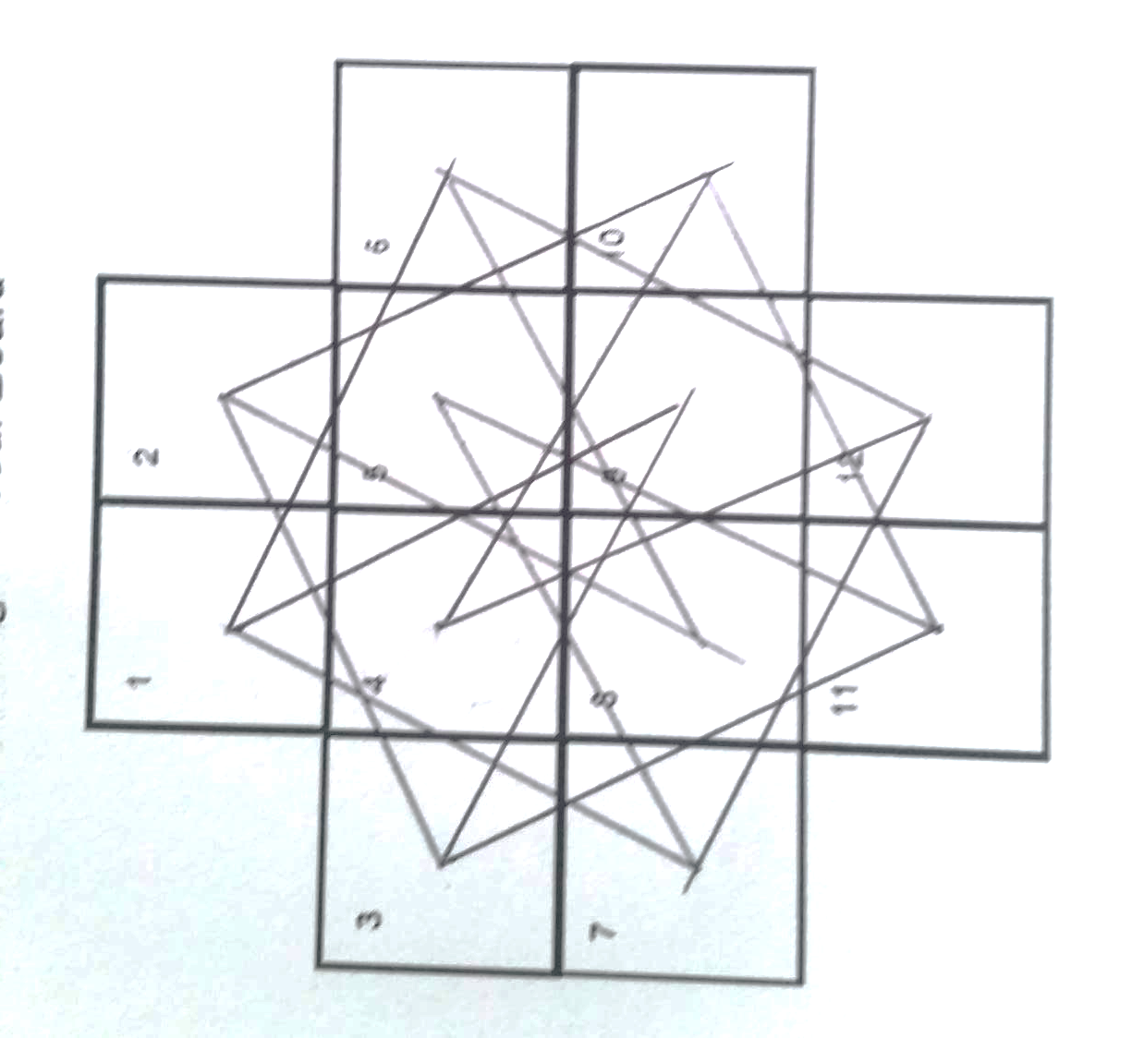
RESULT

Slide 13
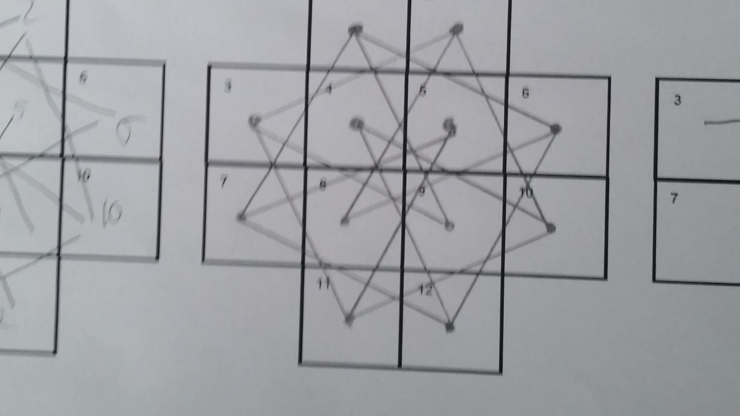
RESULT

Slide 14
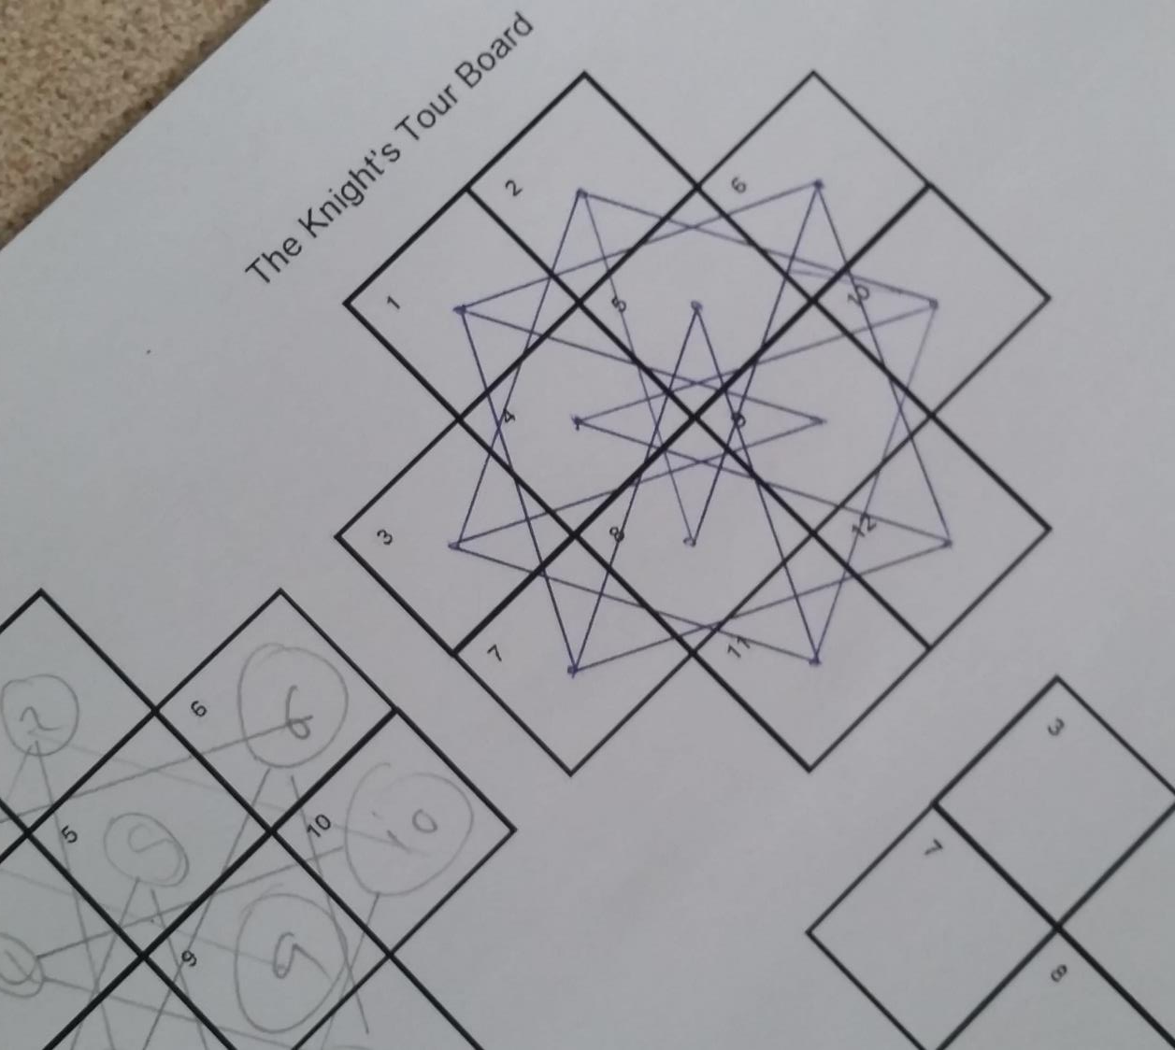
RESULT

Slide 15
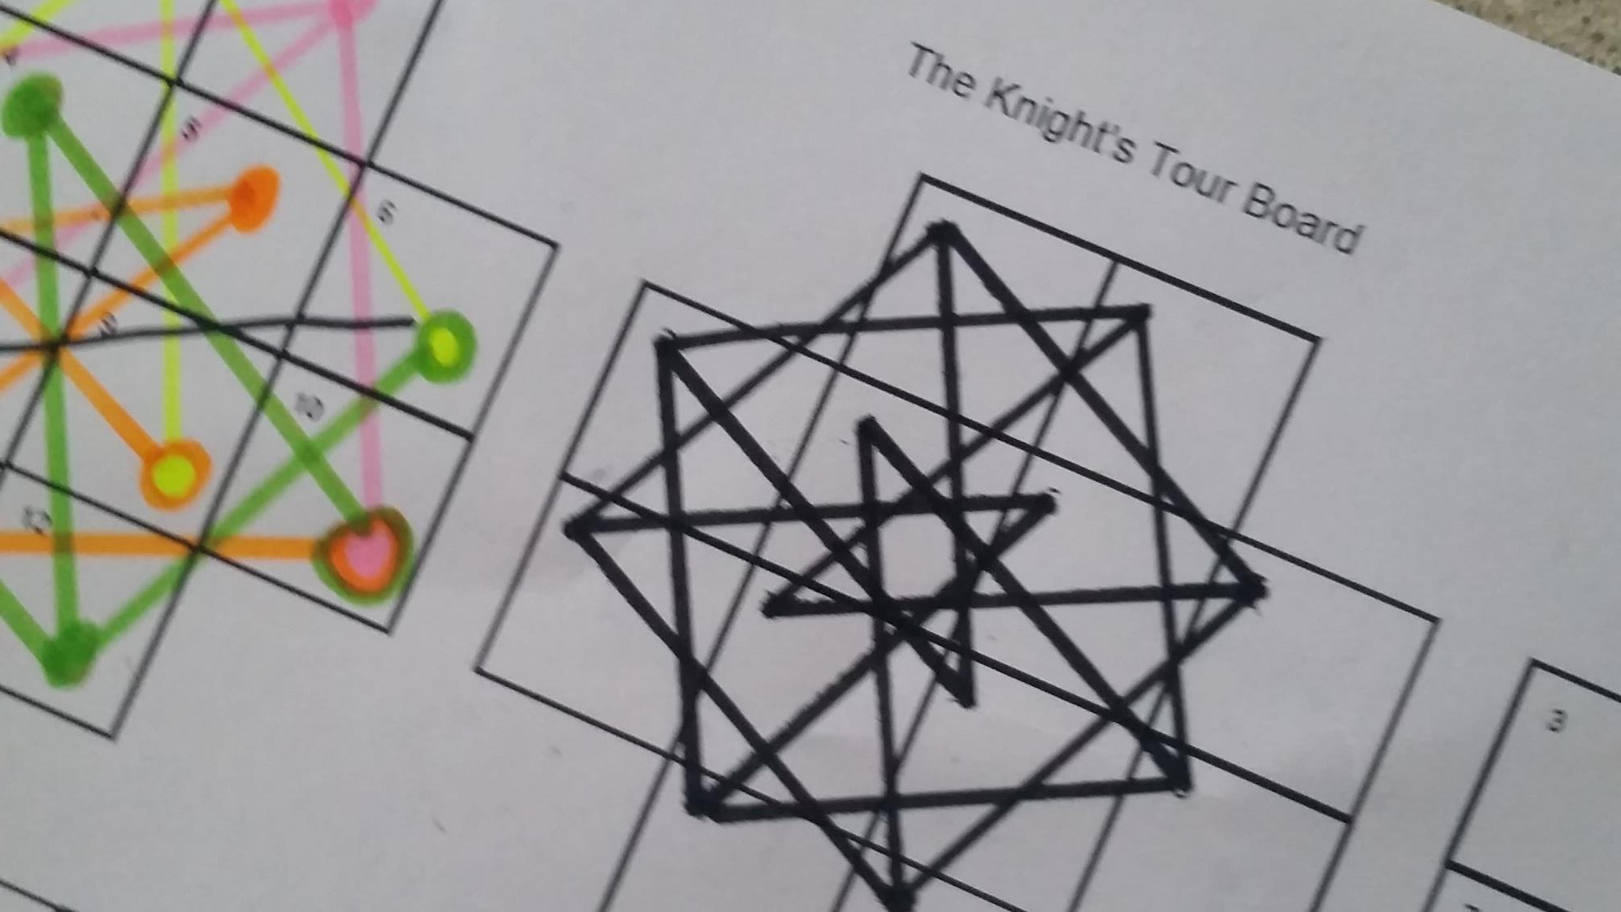
RESULT

Slide 18
Solution
Now you have the diagram of the route
You need to tidy it up into a graph form so that it is easy to view
Ensuring that all the correct nodes touch each other pull the route apart and make it easier to view
Create a nice diagram

Slide 19
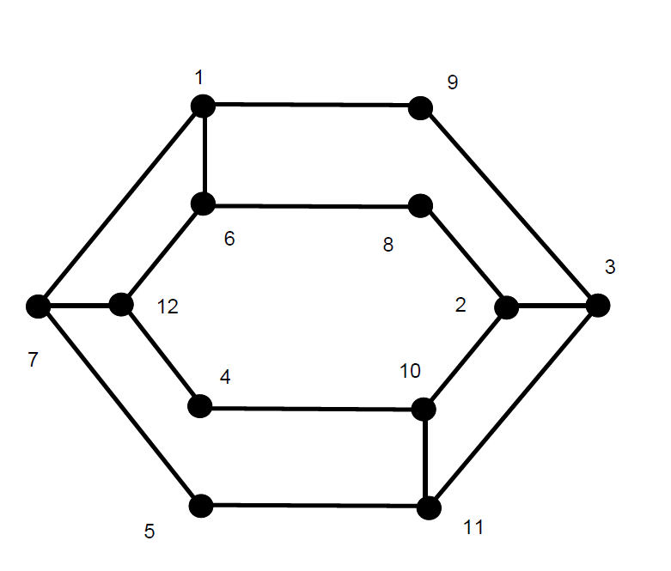

Slide 20
What is the final solution?

Slide 21
What have you learnt?

