Slide 1
Unit 2.3 Robust Programs Lesson 2 - Testing Programs

Slide 2
Starter
For each letter of the Alphabet write down one test that begins with that letter.
For example
D Driving Test
G GCSE exam

Slide 3
Learning Objectives
Understand the purpose of testing
Identify different types of program errors
Know the difference between iterative and terminal testing
Be able to select suitable test data

Slide 4
Key Words
Iterative testing
Final/terminal testing
Syntax Errors
Logic errors
Test Data

Slide 5
Program errors, what is the worst that could happen?
https://www.youtube.com/watch?feature=player_embedded&v=8oI_laHhGjE

Slide 6
Programs errors
What errors have you come across?
Could the Heartbleed have bee avoided?
Who is responsible for the Heartbleed bug?

Slide 7
The Twitter bug
http://www.bbc.co.uk/news/technology-35361150
Discuss this article

Slide 8
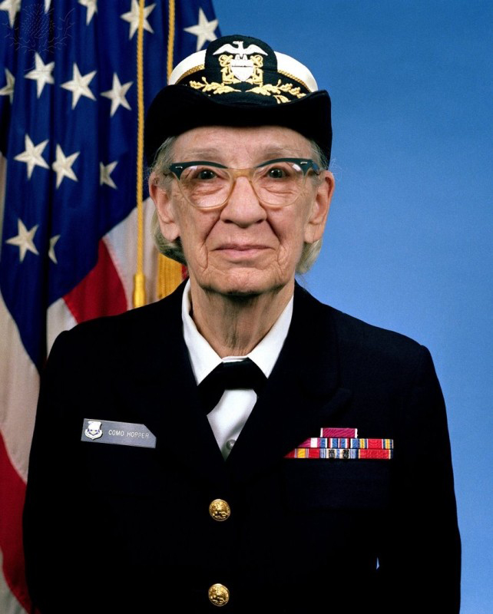
What is a Error
An error in a program is sometimes called a Bug
This is because Grace Hopper discovered a moth in a computer which was stopping it from functioning correctly.

Slide 9
What is a Error
Bugs cause the program to run incorrectly and are usually caused by an error in the coding
Not all errors will stop a program from running

Slide 10
Activity
Look at the code on the following slide
There are some errors/bugs
Can you identify what they are.
Check with another student and compare to see if you have found them all.

Slide 11
Debug this Pseudocode There are three errors
number 1 = input(“Please enter a number”)
number 2 = input (“Please enter another number)
Sum = number 1 / numBer 2
print (Summ)

Slide 12
Activity 1 - Answer
number 1 = input(“Please enter a number”)
number 2 = input (“Please Enter another number”)
Sum = number 1 / number 2
print (Summ)

Slide 13
Runtime errors
Runtime errors are errors which may cause program errors or the computer to crash even if there appears to be nothing wrong with the program code.
They are only detected once the program is executed
Examples could be: Running out of memory

Slide 14
Syntax Errors
Syntax errors are mistakes in the way that the code is written.
Translators can only execute a program if it is syntactically correct.
Common syntax errors include:
spelling mistakes
incorrect use of punctuation
-use of capital letters

Slide 15
Logic Errors
Logic errors: a logic error is a bug in a program that causes it to operate incorrectly, but not to terminate or crash.
A logic error produces unintended or undesired output or other behaviour, although it may not immediately be recognised.

Slide 16
Activity 2
Look back at the code from the previous task and consider each error.
Classify them as either Syntax or Logic errors. Make sure you can justify your answer.

Slide 17
Activity 2 – Identify and define the errors for dividing two numbers
number 1 = input(“Please enter a number”)
output 2 = input (“Please enter another number”)
Sum = number 1 * Number 2
print (sum)

Slide 18
Activity 2 - Answer
number 1 = input(“Please enter a number”)
output 2 = input (“Please enter another number”) SYNTAX
Sum = number 1 * Number 2 LOGIC AND SYNTAX
print (sum)SYNTAX

Slide 19
Types of Testing
Iterative testing is testing the code as you create it.
This could completed line by line or a section at a time.
Once tested and feedback is received you then alter your code as required.
You could consider this type of testing similar to tuning a guitar.
You keep playing the string and adjusting the tension until the note is the correct pitch.

Slide 20
Types of Testing
Final or Terminal testing is carried out at the end of the program when it has been written.
This is more similar to the GCSEs which are taken at the end of the term.
It is used to check what happens when a range of predefined test data is entered or used in the program

Slide 21
Selecting and using Suitable Test Data
When testing the program it is important to use a range of test data
valid/in range
out of range
boundary value
null value
invalid

Slide 22
Selecting and using Suitable Test Data
Valid – Data that is correct
In Range – The maximum values of the data that could be entered for example for teenagers 13 - 19
Out of Range – Values higher or lower than the expect range, for teenagers greater than 19
Null Value – when no data is entered or left blank to test what happens.
Invalid - incorrect values such as entering ‘Dave’ in an age field.

Slide 23
Test Plans
Testing is often completed in a test plan which sets out
The test number
The data entered
The type of test data
The expected outcome
The result of the test
Action required as a result of the test

Slide 24
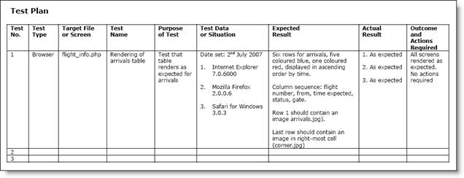
http://www.sqa.org.uk/e-learning/IMAuthoring03CD/images/pic001.jpg

Slide 25
Key Words Recap
Iterative testing
Final/terminal testing
Syntax Errors
Logic errors
Test Data

Slide 26
Plenary
Share with another students three new elements that you have learnt this lesson
Open a program that you have written and test it for errors.
Identify the errors in term so f syntax or logic
Create an example of a logic error in a programing language of your choice

Slide 27
OCR Resources: the small print OCR’s resources are provided to support the teaching of OCR specifications, but in no way constitute an endorsed teaching method that is required by the Board, and the decision to use them lies with the individual teacher. Whilst every effort is made to ensure the accuracy of the content, OCR cannot be held responsible for any errors or omissions within these resources. © OCR 2016 - This resource may be freely copied and distributed, as long as the OCR logo and this message remain intact and OCR is acknowledged as the originator of this work.
OCR acknowledges the use of the following content: Britannica.com/US AIR FORCE, youtube.com/Mashable
Please get in touch if you want to discuss the accessibility of resources we offer to support delivery of our qualifications: resources.feedback@ocr.org.uk

